Slide 1
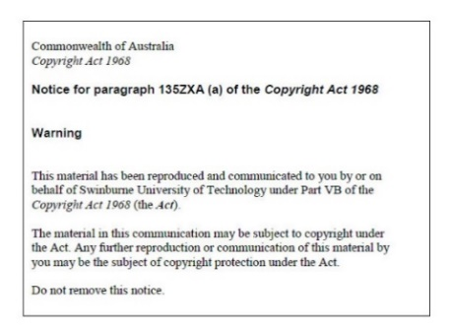
Lecture 06
Responsive CSS
Armita Zarnegar
Check-In
Notes:
20410D
6: Implementing Dynamic Host Configuration Protocol

Slide 2
Overview
Responsive Web Design
Approaches to responsive web design
Tips for responsive CSS
Media Query
Flexbox and Grid
ViewPoint
Making easy responsiveness layouts

Slide 3
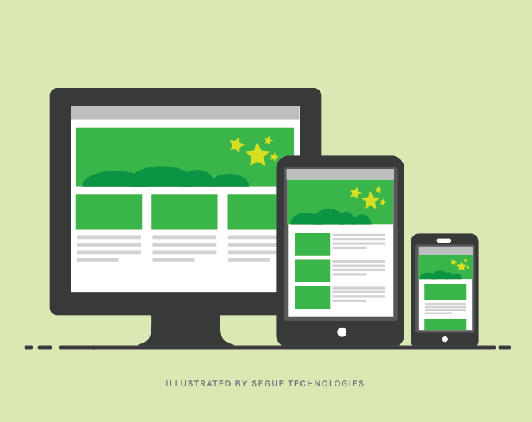
Responsive Web Design
When you use CSS and HTML to resize, hide, shrink, enlarge, or move the content to make it look good on any screen.
A CSS that offers better user experience across different devices and screen sizes
Ref: https://www.seguetech.com/css3-supports-responsive-design/

Slide 4
Approaches to Responsive Web Design
Create a miniaturized version of the larger desktop view first. The miniaturized layout may not provide full experience as some links, text, graphics, and other elements might be too small to adequately interact with.
Create multiple layouts – a fixed width for large and medium screens and fluid widths for smaller screens

Slide 5

Responsive CSS Tips
Use Media Query
Use Relative Units
Use flexbox and grid
Minimize the use of absolute positioning
Optimize images: compressing them and reducing their file size
Test Your Styles

Slide 6
Media Queries
CSS2 introduced media types to enable different style rules to be specified for different devices
CSS3 introduced media queries to expand on the concept of media types in CSS2. they create more precise rules.
Media queries allow you to define rules that only apply to certain conditions, such as the screen size, orientation, resolution, or color depth of the device.
You can specify the minimum or maximum width of the screen and apply styles accordingly.

Slide 7
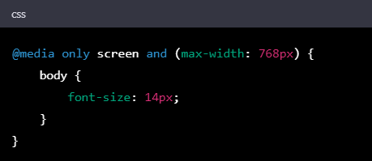
Media Queries
This example applies a different style to a web page when it is viewed on a mobile device with a small screen size. It sets the font size to 14px when the screen size is less than 768 pixels.

Slide 8
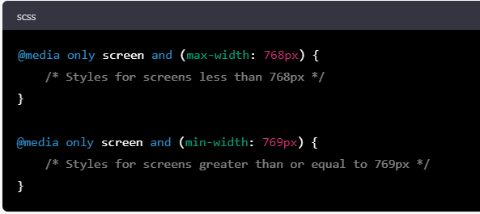
Media Queries
In HTML
<head>: <link rel="stylesheet" media="screen and (max-width:640px)“ href="mobile_device.css" />
In CSS

Slide 9
Media Queries: Within One Stylesheet
@media screen and (max-width:640px) { ... style rules } @media all { body {background-color : blue;} } @media print { body {background-color : white;} .donotdisplay {display: none;} }

Slide 10
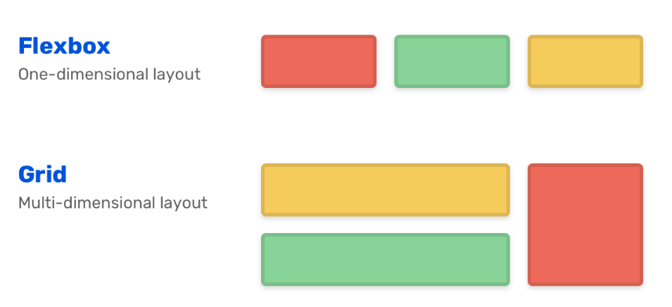
Use Flexbox and Grid
They are used for customisation.
They let you specify how elements should be positioned and sized, making it easier to create layouts that adapt to different screen sizes.

Slide 11
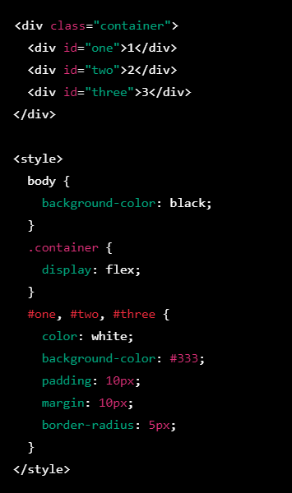
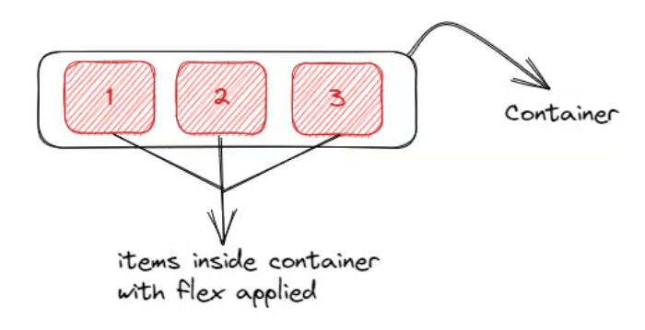
Flexbox

Slide 12
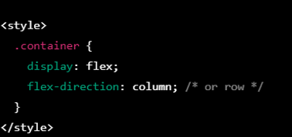
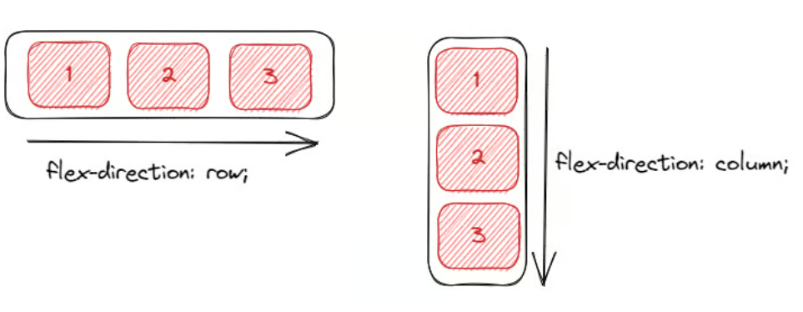
More on Flexbox

Slide 13
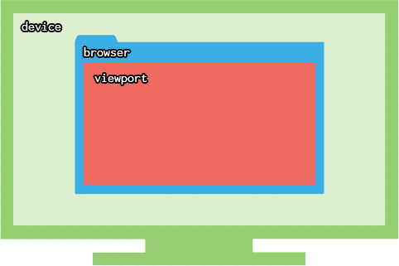
ViewPort
ViewPort defines the area of a webpage which is visible to users.
Its dimensions controls how elements will appear on the webpage.
Use viewport meta tag in the head section of your HTML document, to define the size and scale of the viewport for optimal display on various devices.

Slide 14
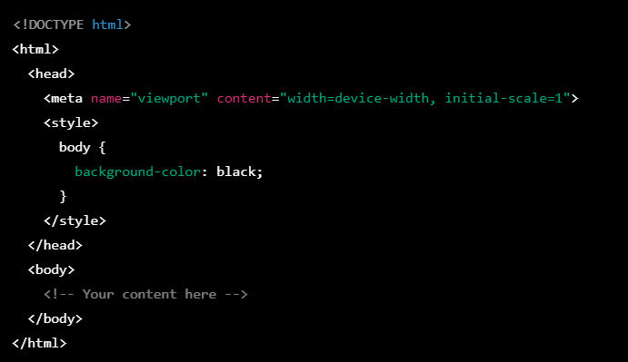
ViewPort – Example
The viewport meta data instructs the page to automatically match the width of the device

Slide 15

Making Responsive Layouts

Slide 16
Wake brain
Which of the following best describes a mobile-first approach to responsive web design?
Designing for desktop screens first and then scaling down for smaller screens
Designing for mobile screens first then scaling up for larger screens
Designing separate websites for mobile and desktop screens
Designing websites without considering screen size and device type
Notes:
B is correct

Slide 17
Wake brain
Which of the following is NOT a common approach to creating responsive web design layouts?
Flexible grid systems
CSS media queries
Fixed-width layouts
Fluid layouts
Notes:
c

Slide 18
Wake brain
Which of the following code snippets is an example of a media query that applies styles only when the viewport width is 600 pixels or more?
@media screen and (max-width: 600px) { ... }
@media screen and (min-width: 600px) { ... }
@media screen and (width: 600px) { ... }
@media screen and (device-width: 600px) { ... }
Notes:
Answer is B

